Slide 1
Chapter 28 - Java Graphics and Java2D
Outline
28.1 Introduction
28.2 Graphics Contexts and Graphics Objects
28.3 Color Control
28.4 Font Control
28.5 Drawing Lines, Rectangles and Ovals
28.6 Drawing Arcs
28.7 Drawing Polygons and Polylines
28.8 The Java2D API
28.9 Java2D Shapes

Slide 2
Objectives
In this chapter, you will learn:
  To understand graphics contexts and graphics objects.
  To understand and be able to manipulate colors.
  To understand and be able to manipulate fonts.
  To understand and be able to use Graphics methods for drawing lines, rectangles, rectangles with rounded corners, three-dimensional rectangles, ovals, arcs and polygons.
  To use methods of class Graphics2D from the Java2D API to draw lines, rectangles, rectangles with rounded corners, ellipses, arcs and general paths.
  To be able to specify Paint and Stroke characteristics of shapes displayed with Graphics2D.

Slide 3
28.1 Introduction
In this chapter
  Draw 2D shapes
  Colors
  Fonts
Java appealing for its graphics support
  Has a class hierarchy for its graphics classes and 2D API classes

Slide 4
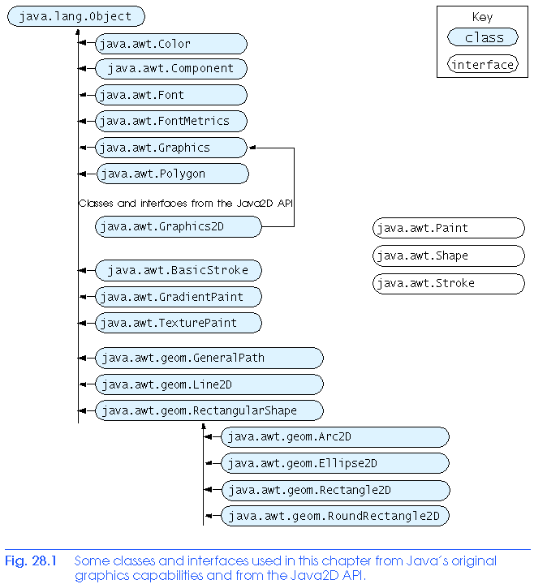
28.1 Introduction

Slide 5
28.1 Introduction
Java coordinate system
  (x,y) pairs
    x - horizontal axis
    y - vertical axis
  Upper left corner is (0,0)
  Coordinates measured in pixels (smallest unit of resolution)

Slide 6
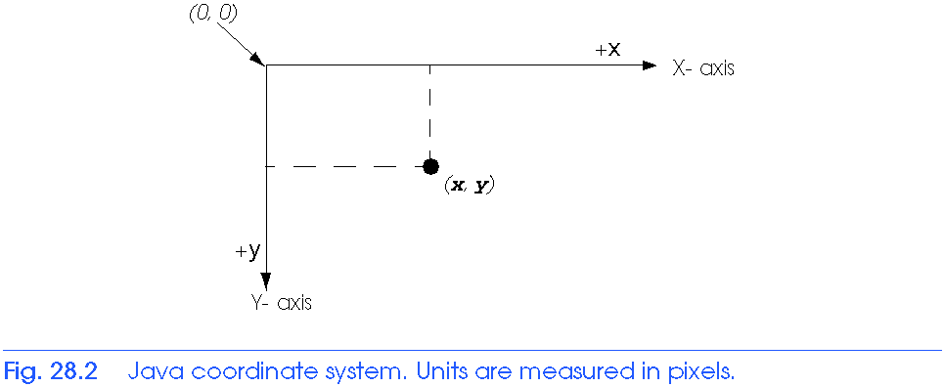
28.1 Introduction

Slide 7
28.2 Graphics Contexts and Graphics Objects
Graphics context
  Enables drawing on screen
  Graphics object manages graphics context
    Controls how information is drawn
    Has methods for drawing, font manipulation, etc
    We have used Graphics object g for applets
  Graphics an abstract class
    Cannot instantiate objects
    Implementation hidden - more portable
Class Component
  Superclass for many classes in java.awt
  Method paint takes Graphics object as argument

Slide 8
28.2 Graphics Contexts and Graphics Objects
Class Component
  paint called automatically when applet starts
  paint often called in response to an event
    Drawing graphics is an event-driven process.
  repaint calls update, which forces a paint operation
    update rarely called directly
    Sometimes overridden to reduce "flicker"
    Headers:
    public void repaint()
    public void update( Graphics g )
In this chapter
  Focus on paint method

Slide 9
28.3 Color Control
Class Color
  Defines methods and constants for manipulating colors
  Colors created from red, green, and blue component
    RGB value: 3 integers from 0 to 255 each, or three floating point values from 0 to 1.0 each
    Larger the value, more of that color
  Color methods getRed, getGreen, getBlue return an integer between 0 and 255 representing amount
  Graphics method setColor sets drawing color
    Takes Color object
  Method getColor gets current color setting

Slide 10
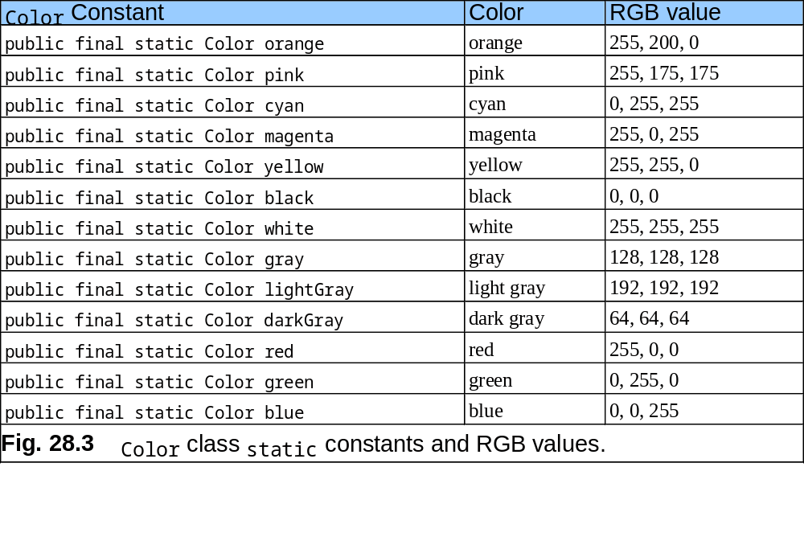
28.3 Color Control

Slide 11
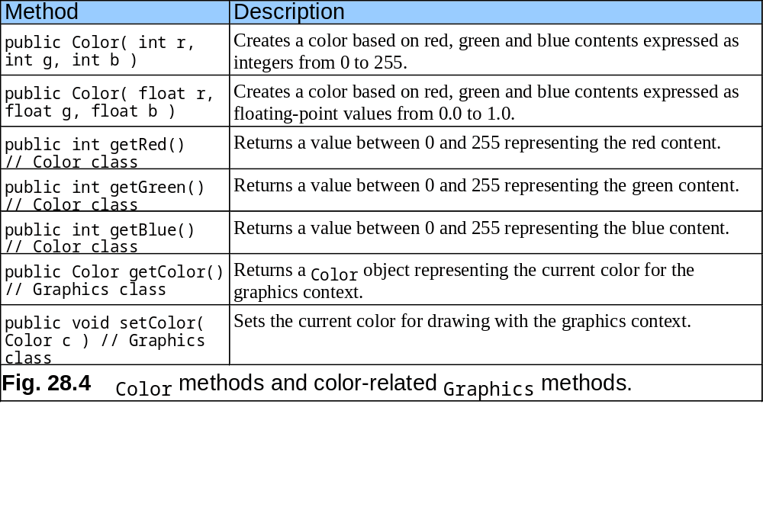
28.3 Color Control

Slide 12
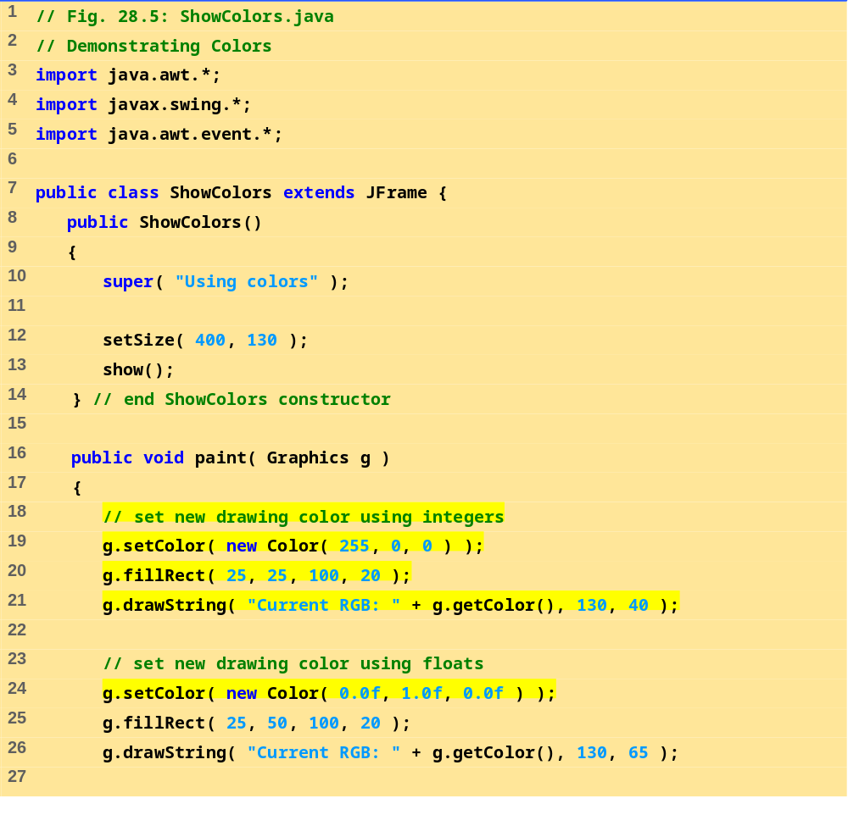
ShowColors.java (1 of 2)

Slide 13
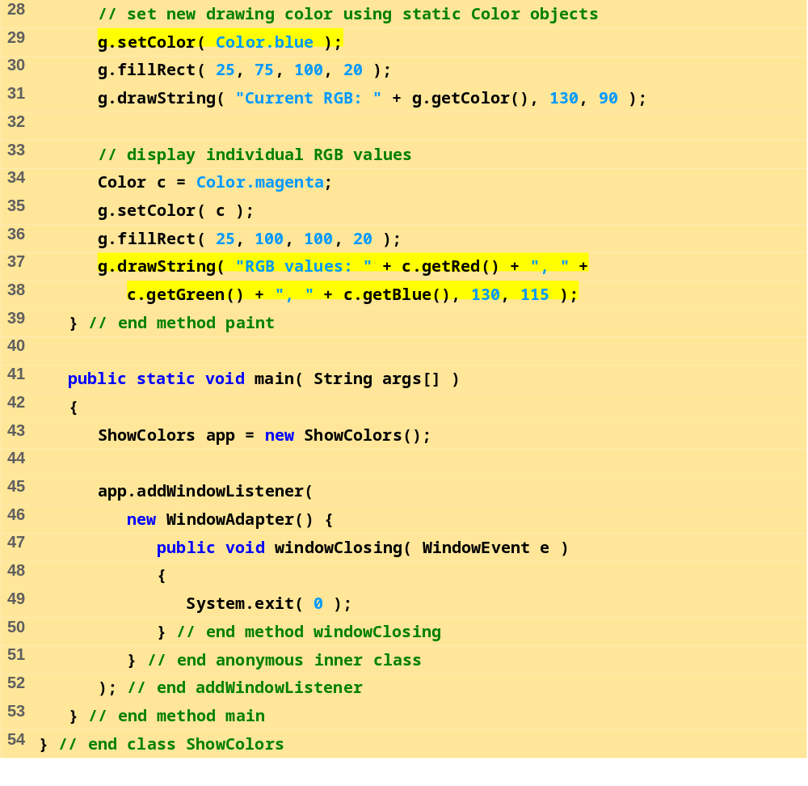
ShowColors.java (2 of 2)

Slide 14
28.3 Color Control
Component JColorChooser
  Displays dialog allowing user to select a color
  Method showDialog
    First argument: reference to parent Component (window from which dialog being displayed)
      Modal dialog - user cannot interact with other dialogs while active
    Second argument: String for title bar
    Third argument: Initial selected color
    Returns a Color object
Class Container
  Method setBackground - takes Color object
  Sets background color

Slide 15
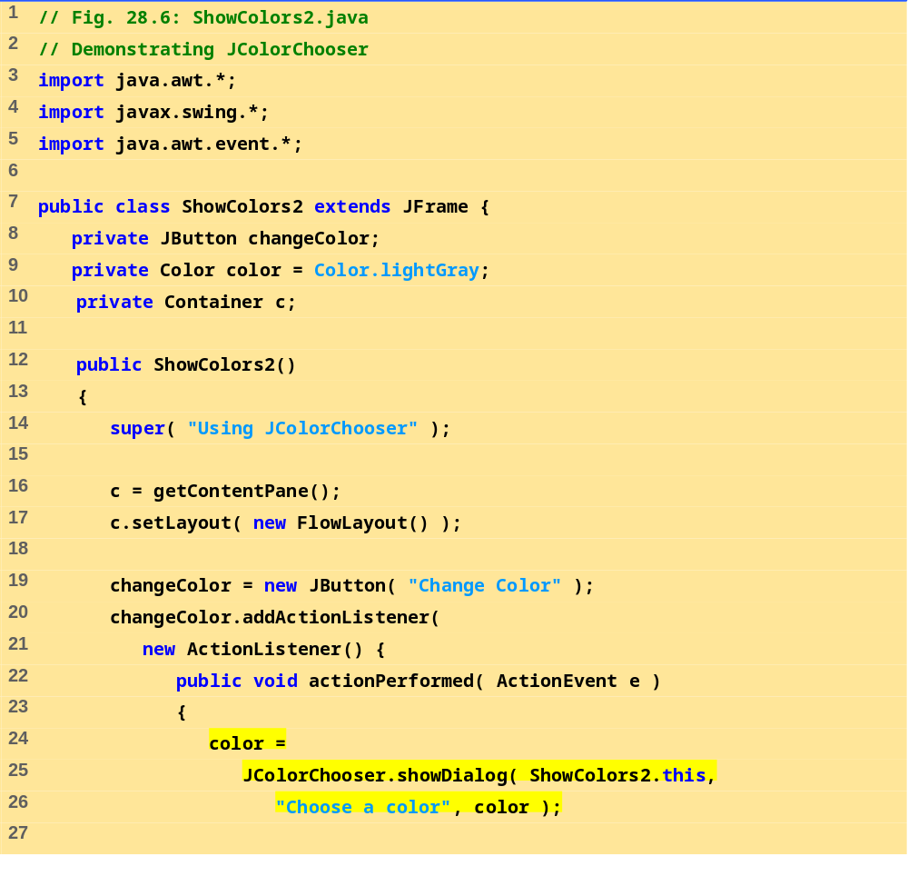
ShowColors2.java
(1 of 2)

Slide 16
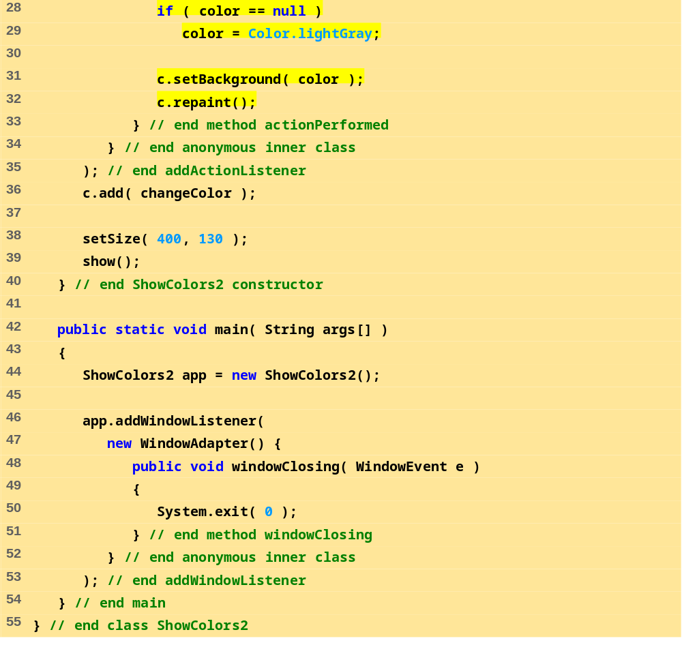
ShowColors2.java
(2 of 2)

Slide 17
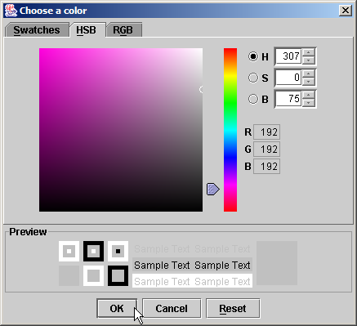
28.3 Color Control
Fig. 28.7 The HSB and RGB tabs of the JColorChooser dialog.

Slide 18
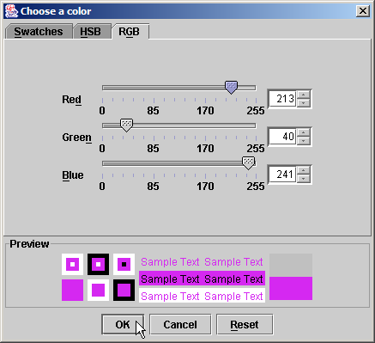
28.3 Color Control
Fig. 28.7 The HSB and RGB tabs of the JColorChooser dialog.

Slide 19
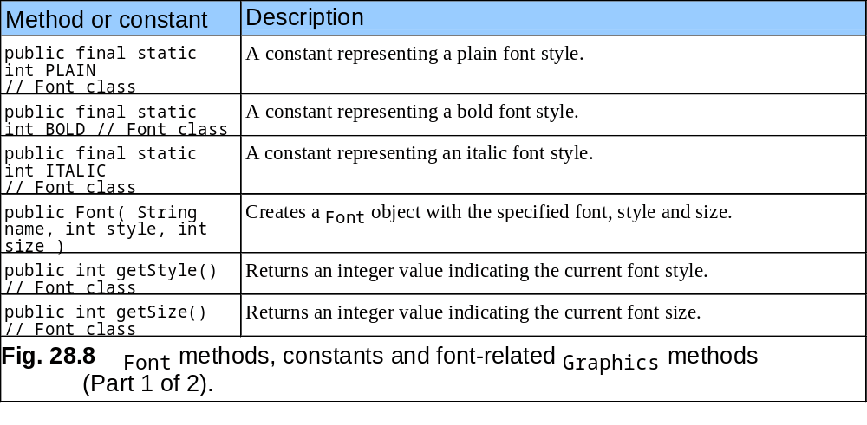
28.4 Font Control

Slide 20
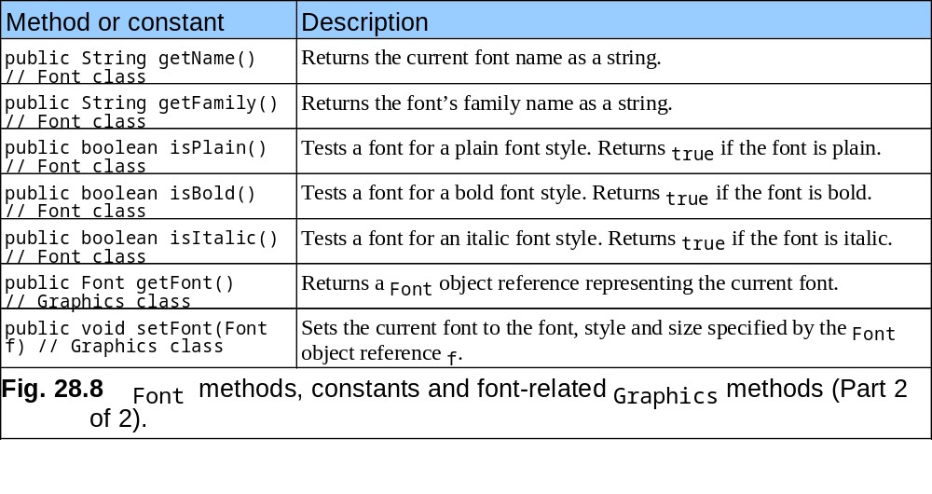
28.4 Font Control

Slide 21
28.4 Font Control
Class Font
  Constructor takes three arguments
  public Font( String name, int style, int size)
    name: any font supported by system (Serif, Monospaced)
    style: constants FONT.PLAIN, FONT.ITALIC, FONT.BOLD
      Combinations: FONT.ITALIC + FONT.BOLD
    size: measured in points (1/72 of an inch)
  Usage:
    g.setFont( fontObject );

Slide 22
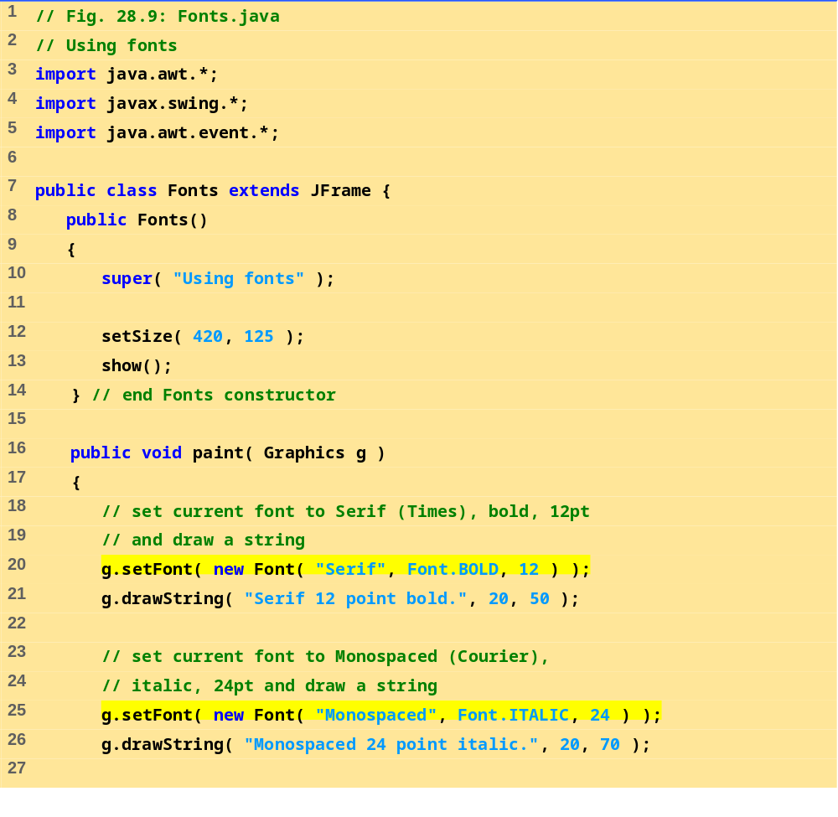
Fonts.java (1 of 2)

Slide 23
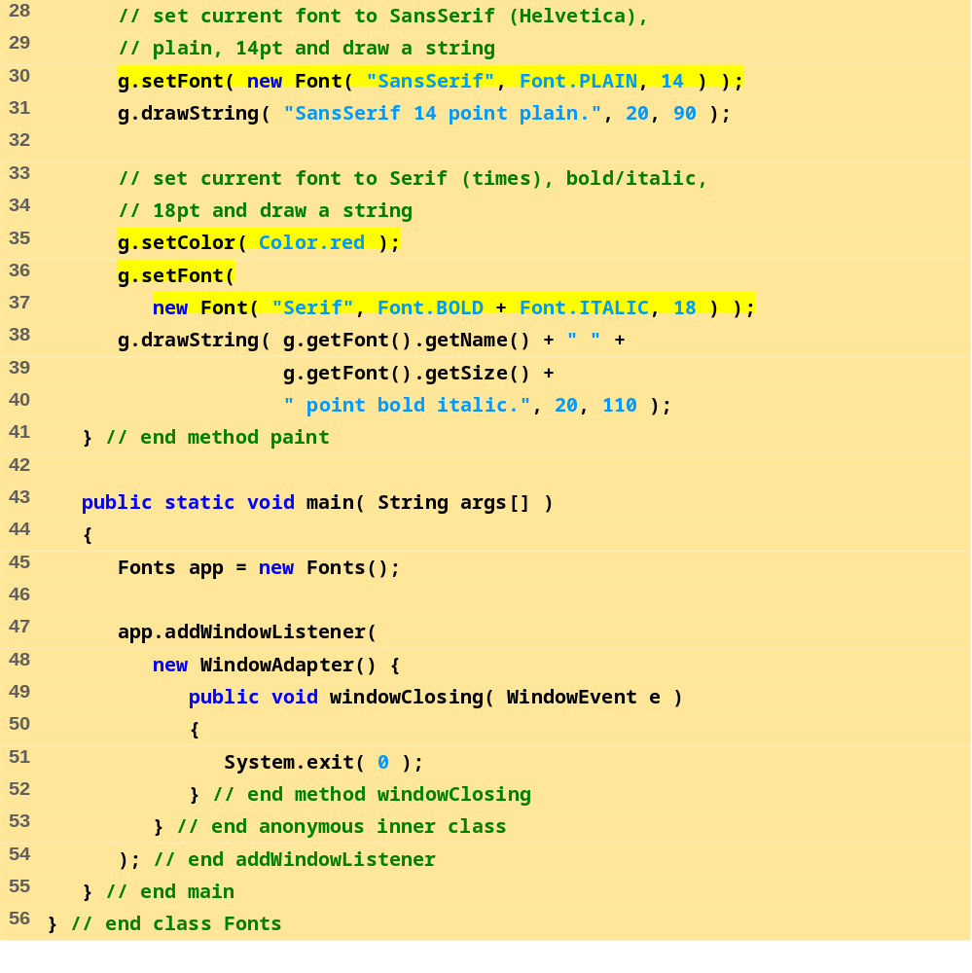
Fonts.java (2 of 2)

Slide 24
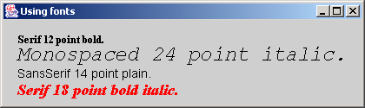
28.4 Font Control
Figure 28.9 Using Graphics method setFont to change Fonts.

Slide 25
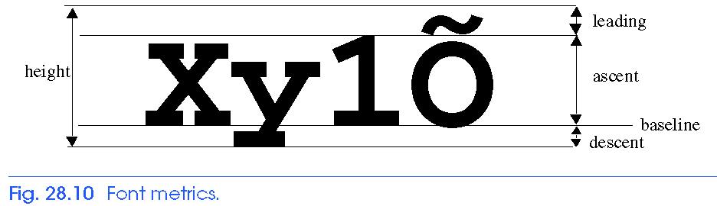
28.4 Font Control
Class FontMetrics
  Has methods for getting font metrics
  g.getFontMetrics - returns FontMetrics object

Slide 26
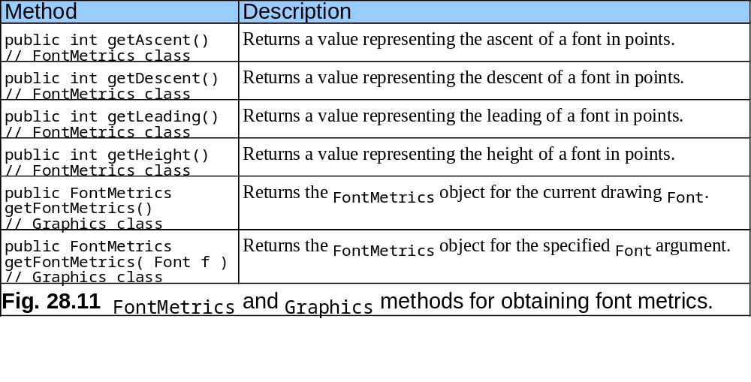
28.4 Font Control

Slide 27
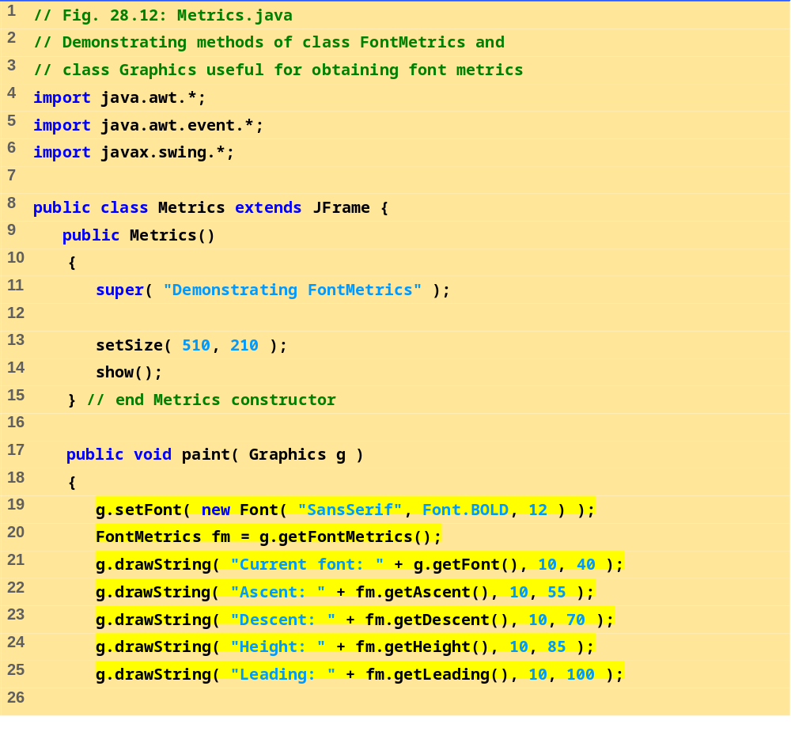
Metrics.java (1 of 2)

Slide 28
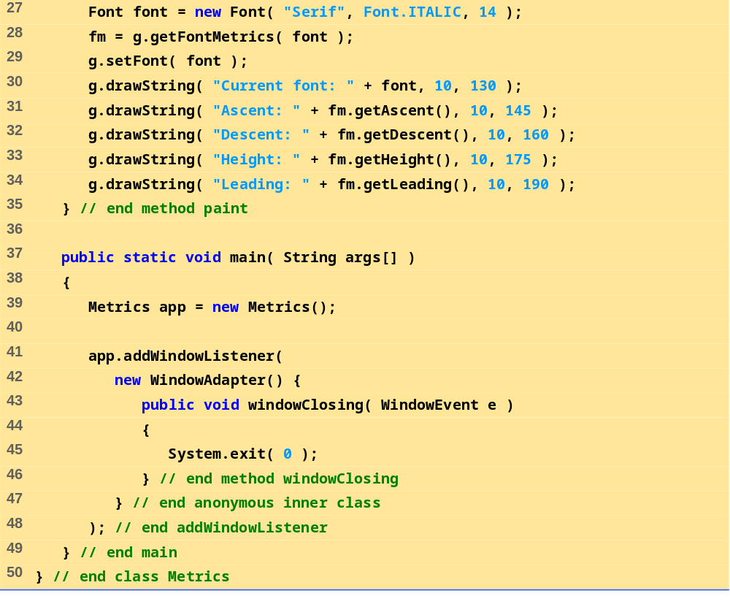
Metrics.java (2 of 2)

Slide 29
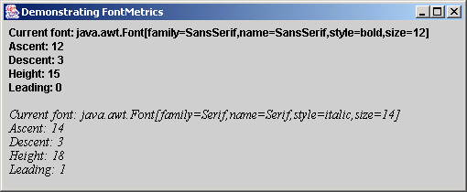
28.4 Font Control
Figure 28.12 Obtaining font metric information.

Slide 30
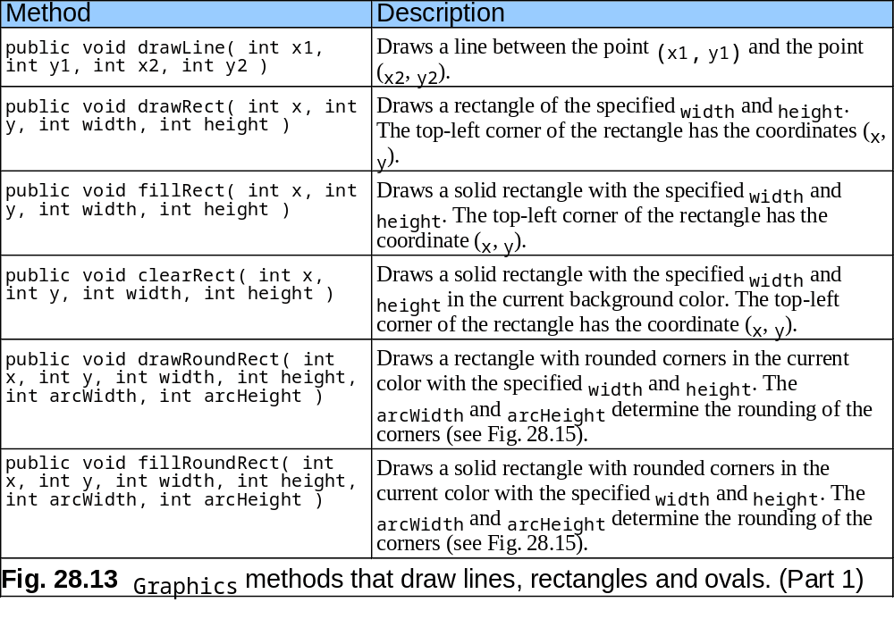
28.5 Drawing Lines, Rectangles and Ovals

Slide 31
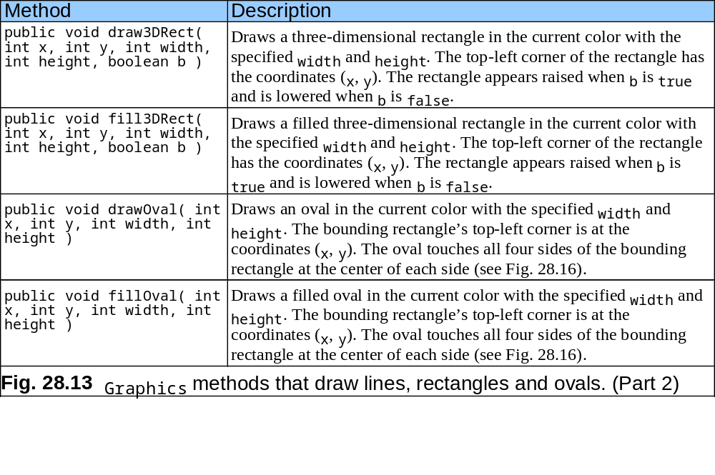
28.5 Drawing Lines, Rectangles and Ovals

Slide 32
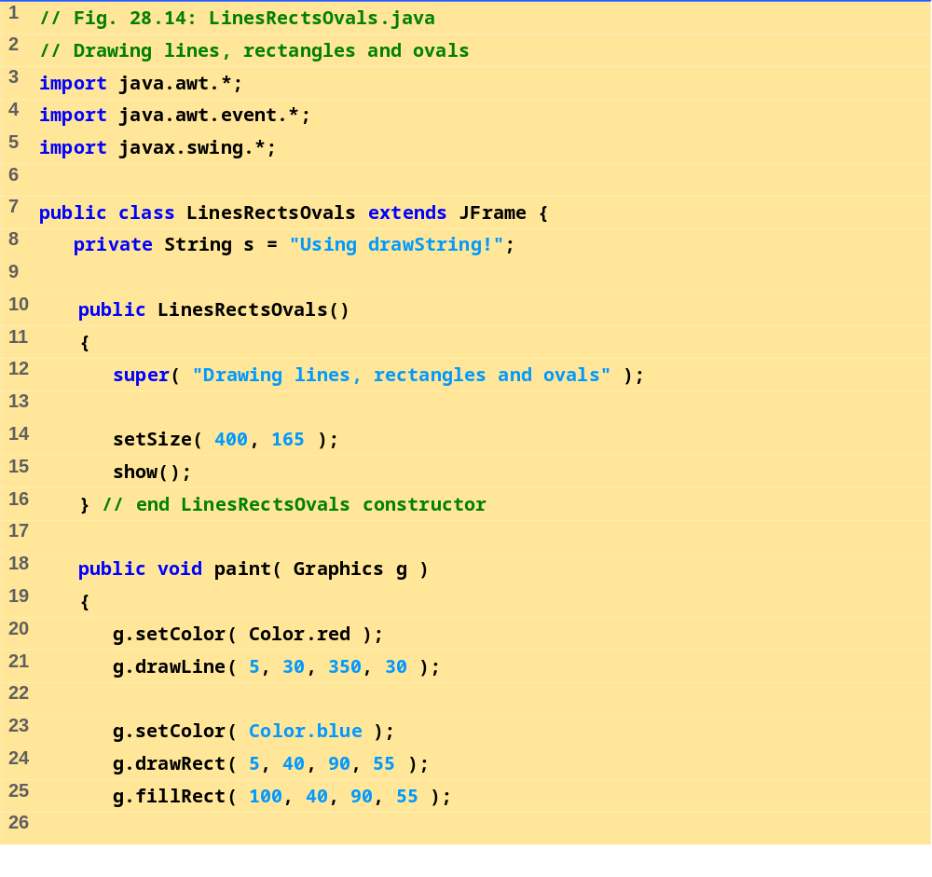
LinesRectsOvals.java
(1 of 2)

Slide 33
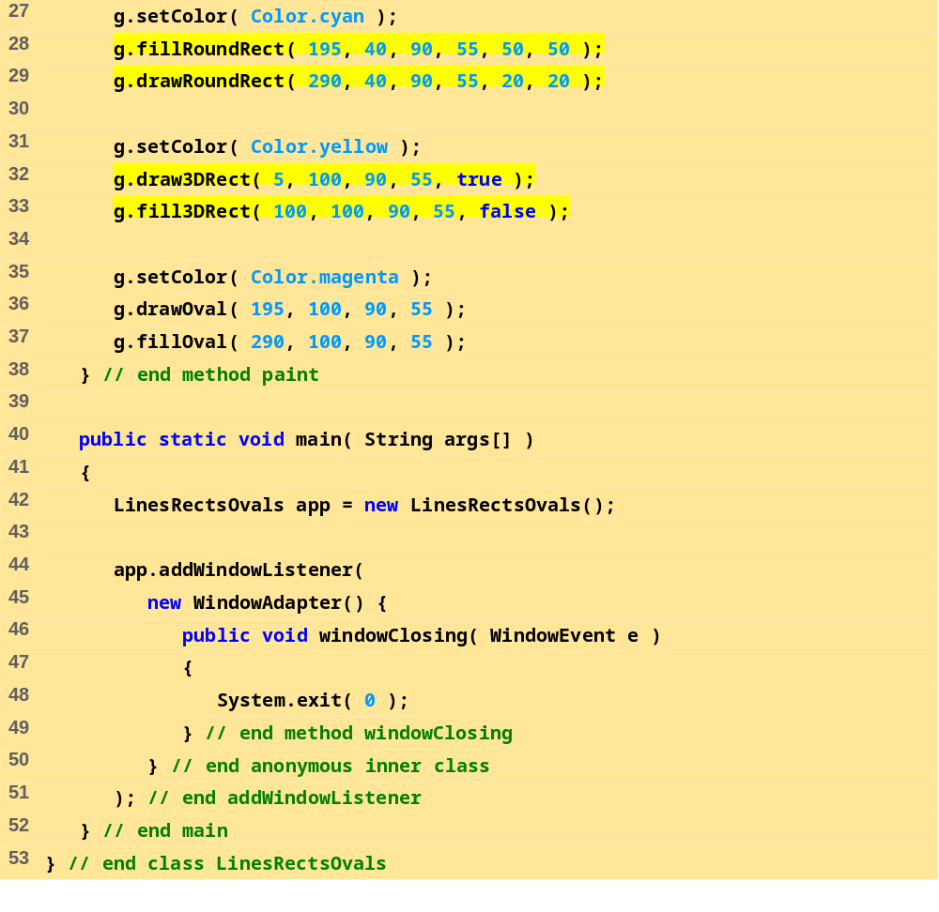
LinesRectsOvals.java
(2 of 2)

Slide 34
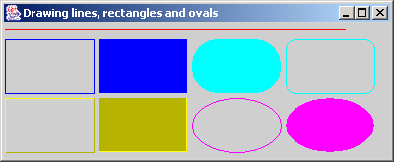
28.5 Drawing Lines, Rectangles and Ovals
Figure 28.14 Demonstrating Graphics method drawLine.
drawLine
fillRoundRect
drawRect
drawRoundRect
fillRect
drawOval
draw3DRect
fillOval
fill3DRect

Slide 35
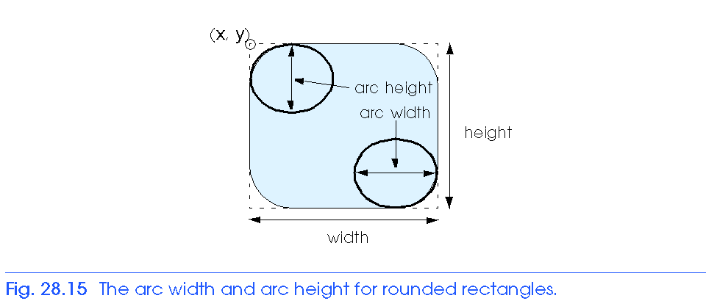
28.5 Drawing Lines, Rectangles and Ovals

Slide 36
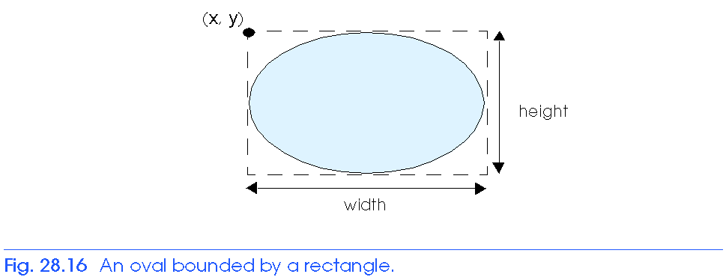
28.5 Drawing Lines, Rectangles and Ovals

Slide 37
28.6 Drawing Arcs
Arc
  Portion of an oval
  Arc angles measured in degrees
    Starts at a starting angle and sweeps the number of degrees specified by arc angle
    Positive - counterclockwise
    Negative - clockwise
  When drawing an arc, specify bounding rectangle for an oval
  drawArc( x, y, width, height, startAngle, arcAngle )
  fillArc - as above, but draws a solid arc (sector)

Slide 38
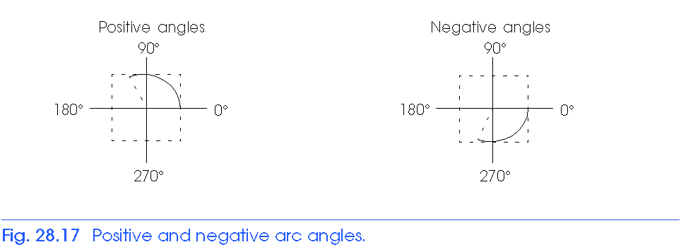
28.6 Drawing Arcs

Slide 39
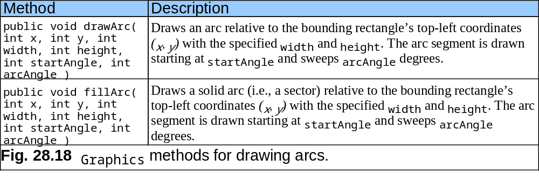
28.6 Drawing Arcs

Slide 40
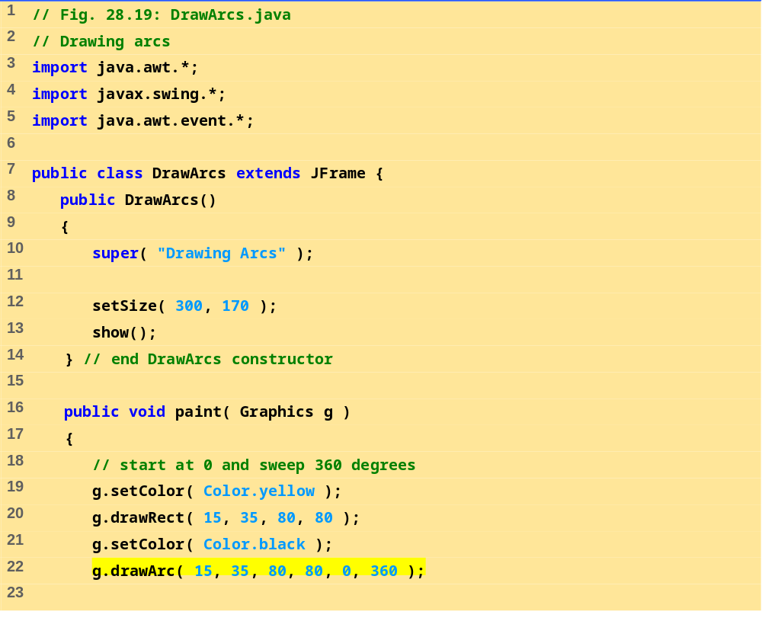
DrawArcs.java (1 of 3)

Slide 41
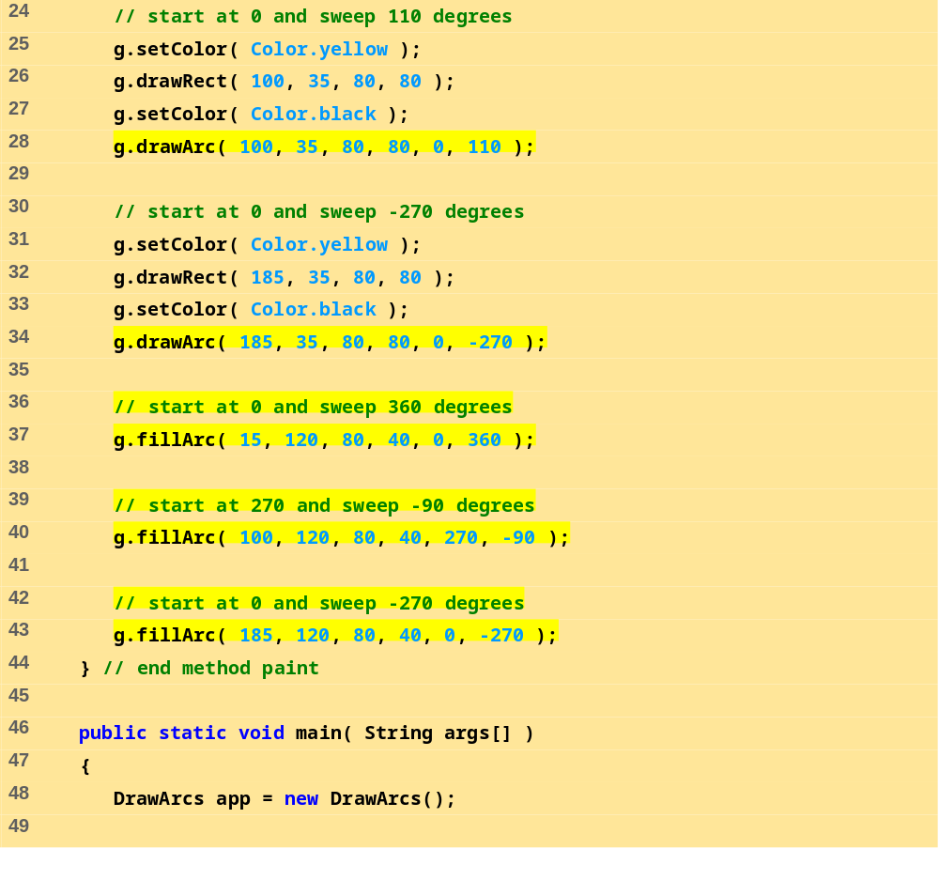
DrawArcs.java (2 of 3)

Slide 42
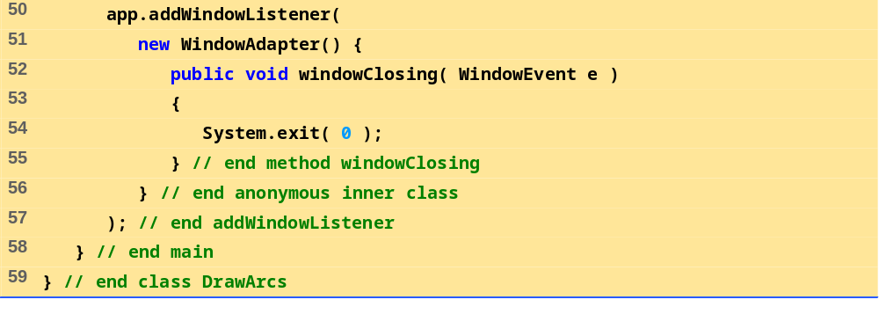
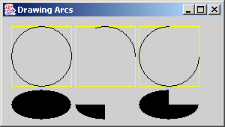
DrawArcs.java (3 of 3)

Slide 43
28.7 Drawing Polygons and Polylines
Polygon - multisided shape
  In Java, class Polygon
    java.awt
Polyline - series of connected points

Slide 44
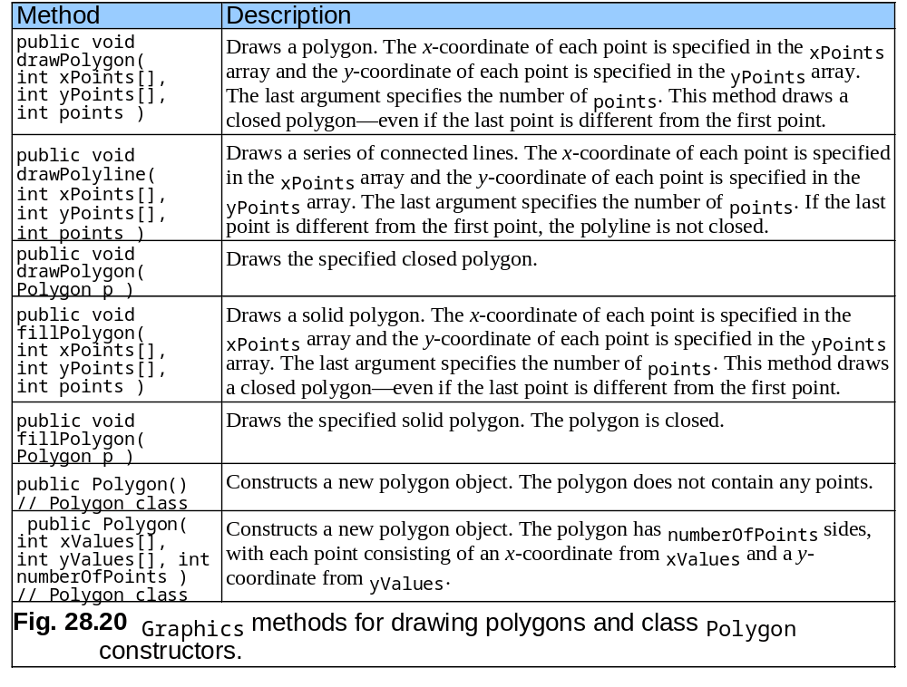
28.7 Drawing Polygons and Polylines

Slide 45
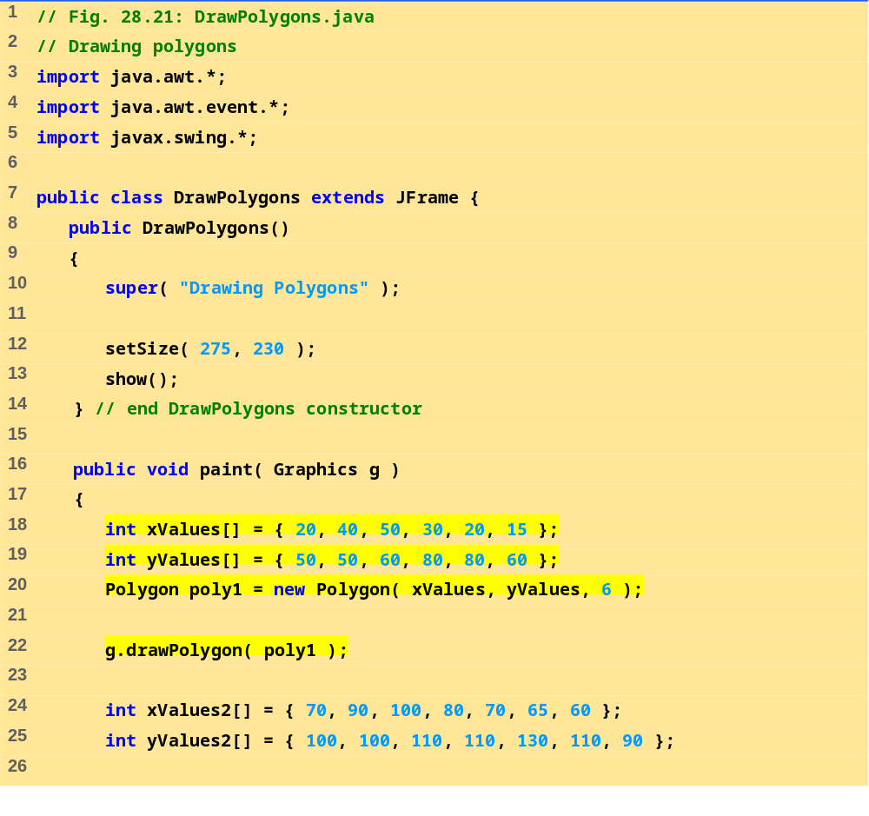
DrawPolygons.java
(1 of 3)

Slide 46
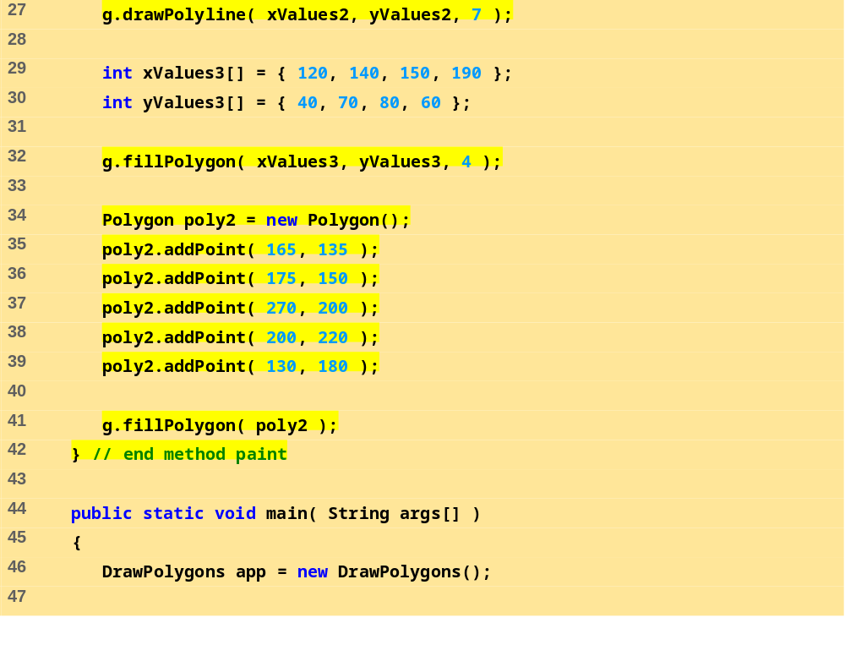
DrawPolygons.java
(2 of 3)

Slide 47
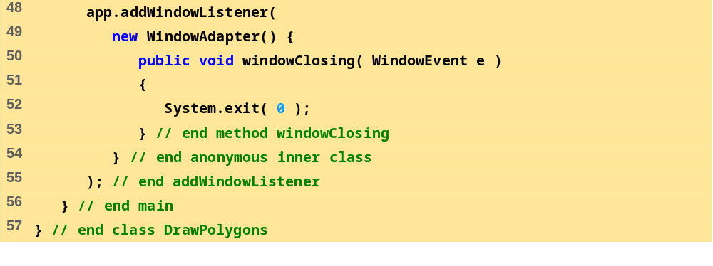
DrawPolygons.java
(3 of 3)

Slide 48
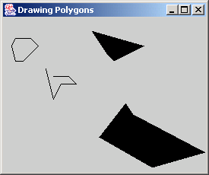
28.7 Drawing Polygons and Polylines
Figure 28.21 Demonstrating drawPolygon and fillPolygon.
Result of line 32
Result of line 22
Result of line 41
Result of line 27

Slide 49
28.8 The Java2D API
Java2D API
  Advanced two dimensional graphics capabilities
  Too many capabilities to cover (for overview, see demo)
Drawing with the Java2D API
  Use instance of class Graphics2D (package java.awt)
    Subclass of Graphics
    Has all graphics capabilities we have previously discussed
  Must downcast Graphics reference passed to paint
  Graphics2D g2d = ( Graphics2D ) g;
  This technique used in programs of next section

Slide 50
28.9 Java2D Shapes
Sample methods from Graphics2D
  setPaint ( paintObject )
    Paint object is an object of a class that implements java.awt.Paint
    Can be an object of class Color, GradientPaint, SystemColor, TexturePaint
  GradientPaint ( x1, y1, color1, x2, y2, color2, cyclic )
    Creates a gradient (slowly changing color) from x1, y1, to x2, y2, starting with color1 and changing to color2
    If cyclic true, then cyclic gradient (keeps transitioning colors)
      If acyclic, only transitions colors once

Slide 51
28.9 Java2D Shapes
Sample methods from Graphics2D
  fill ( shapeObject )
    Draws a filled Shape object
    Instance of any class that implements Shape (java.awt)
    Ellipse2D.Double, Rectangle2D.Double
    Double-precision inner classes of Ellipse2D
  setStroke( strokeObject )
    Set a shape's borders
    Instance of a class that implements Stroke (java.awt)
    BasicStroke( width ) - One of many constructors
      This constructor specifies width in pixels of border

Slide 52
28.9 Java2D Shapes
Sample methods from Graphics2D
  draw ( shapeObject )
    Draws specified Shape object
  Class BufferedImage
    Can produce images in color or grayscale
    Can create patterns by drawing into the BufferedImage object
  Class TexturePaint
    Constructor can take BufferedImage and shape to fill
    Object of class TexturePaint then drawn using setPaint
    Book has further details

Slide 53
28.9 Java2D Shapes
Class Arc2D.Double
  Similar to normal arcs, except has another argument at end
    Arc2D.PIE - close arc with two lines
    Arc2D.CHORD - draws line from endpoints of arc
    Arc2D.OPEN - arc not closed
Class BasicStroke
  Can be used to create customized dashed lines, set how lines end and join

Slide 54
28.9 Java2D Shapes
Class GeneralPath
  A general path is a shape made from lines and curves
  Method moveTo
    Specifies first point in a general path
  Method lineTo
    Draws a line to next point in general path
  Method closePath
    Draws line from last point to point specified in last call to moveTo
Other methods
  rotate( radians ) - rotate next shape around origin
  translate(x, y) - translates origin to x, y

Slide 55
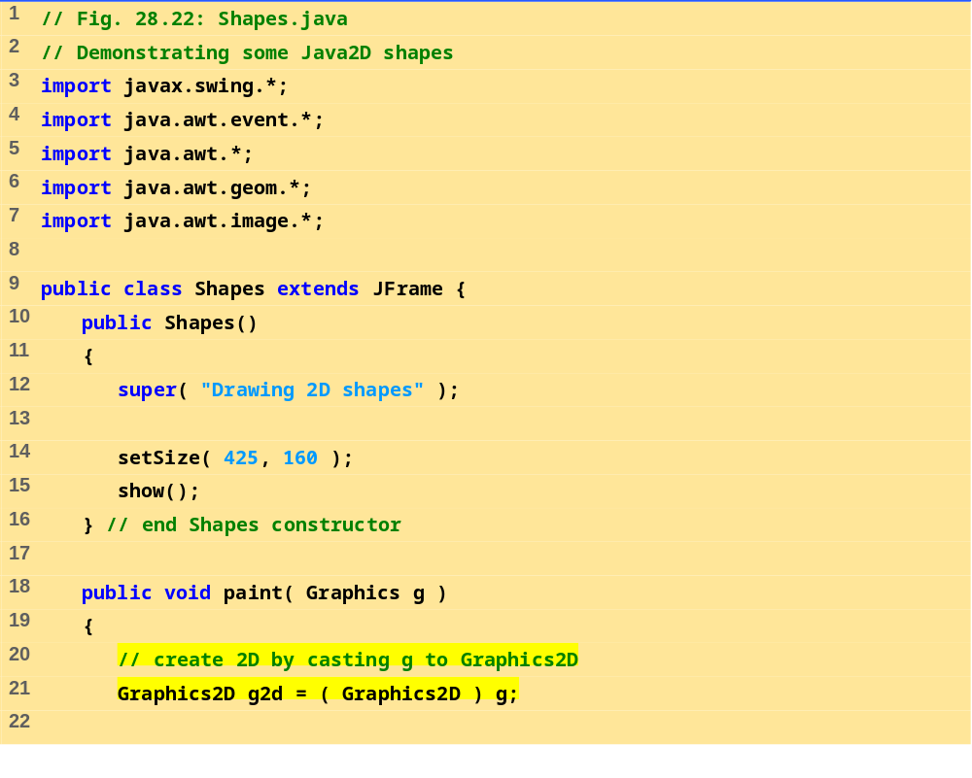
Shapes.java (1 of 4)

Slide 56
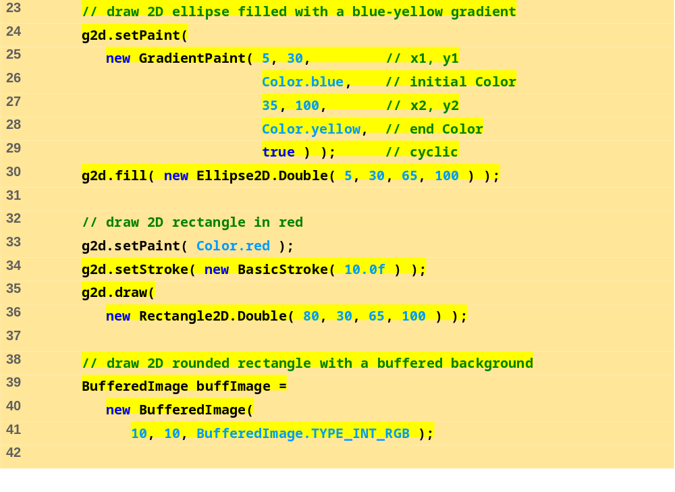
Shapes.java (2 of 4)

Slide 57
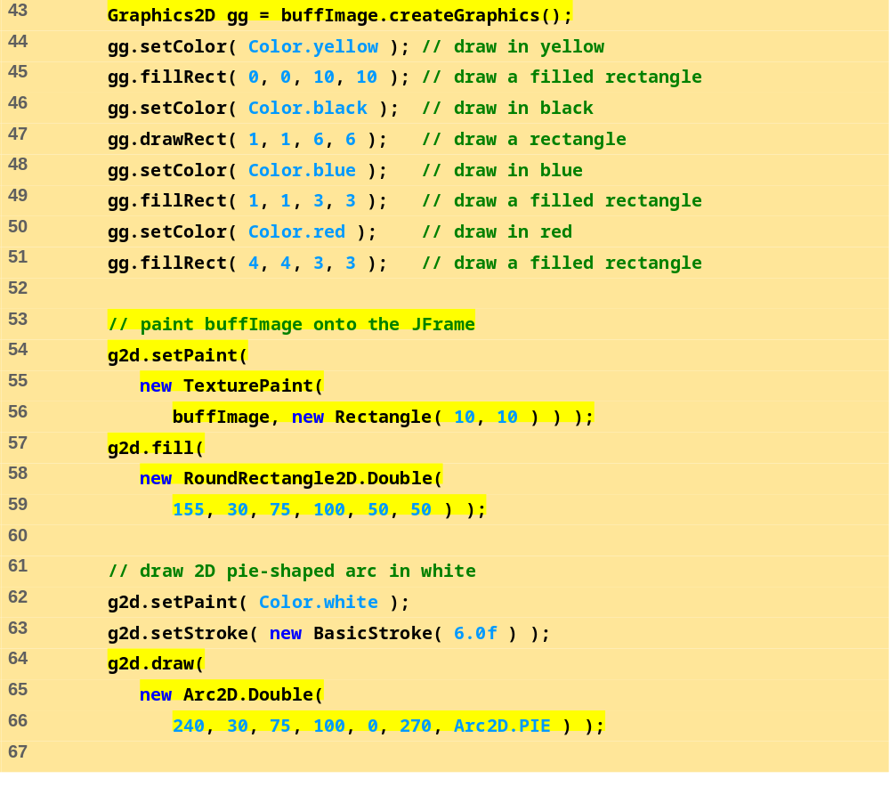
Shapes.java (3 of 4)

Slide 58
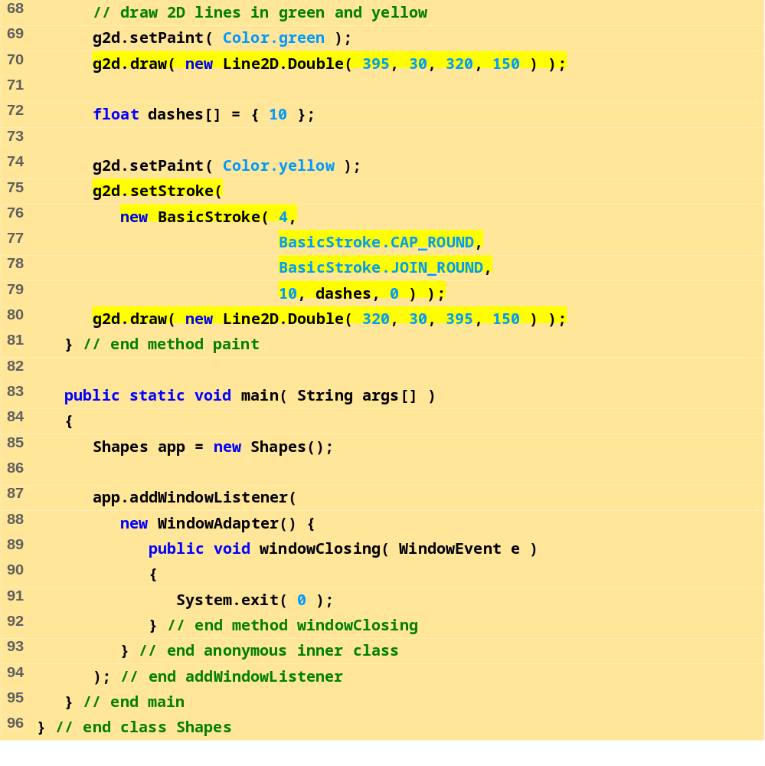
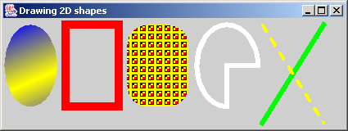
Shapes.java (4 of 4)

Slide 59
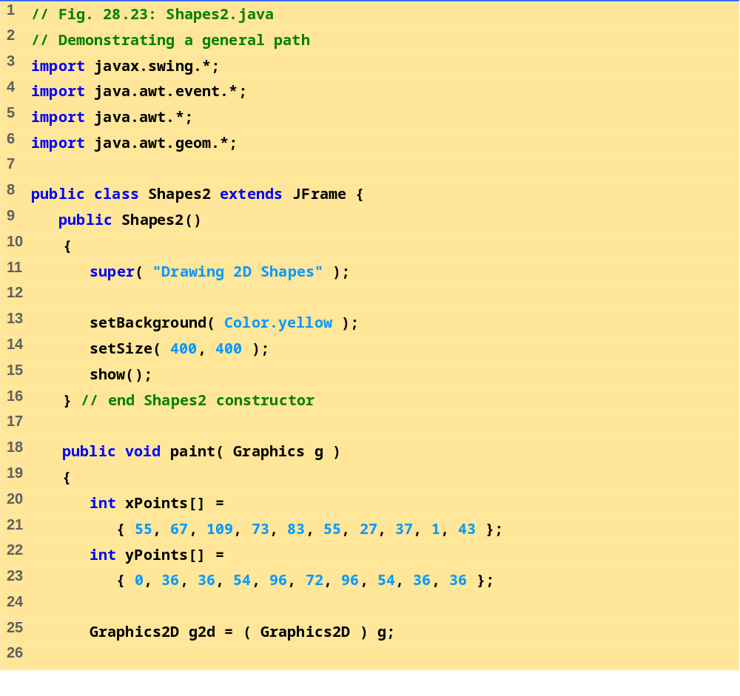
Shapes2.java (1 of 3)

Slide 60
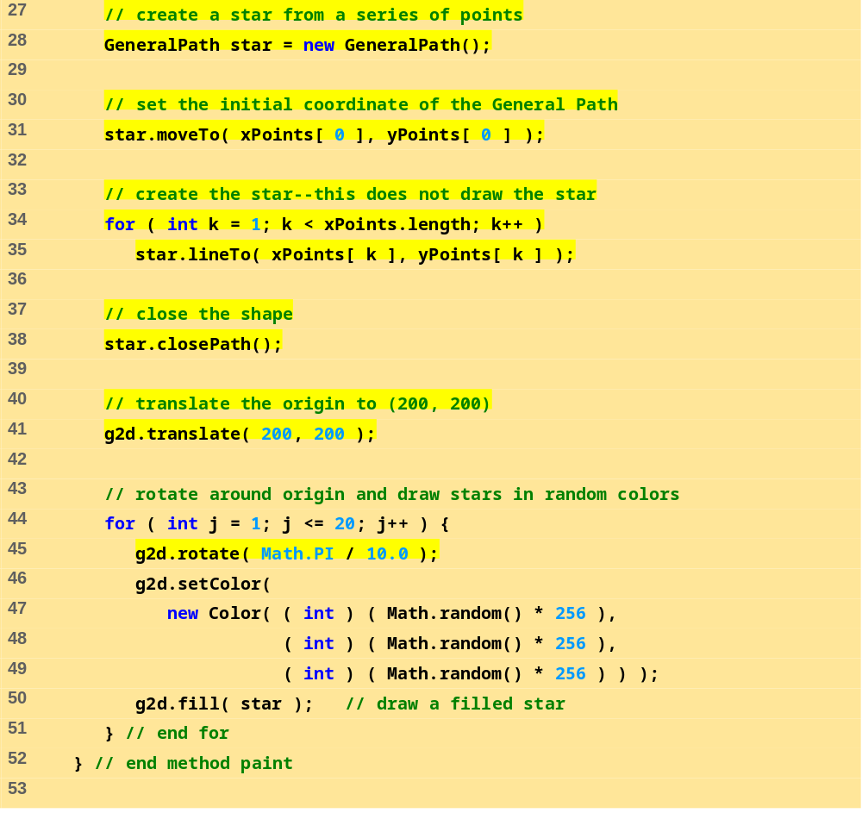
Shapes2.java (2 of 3)

Slide 61
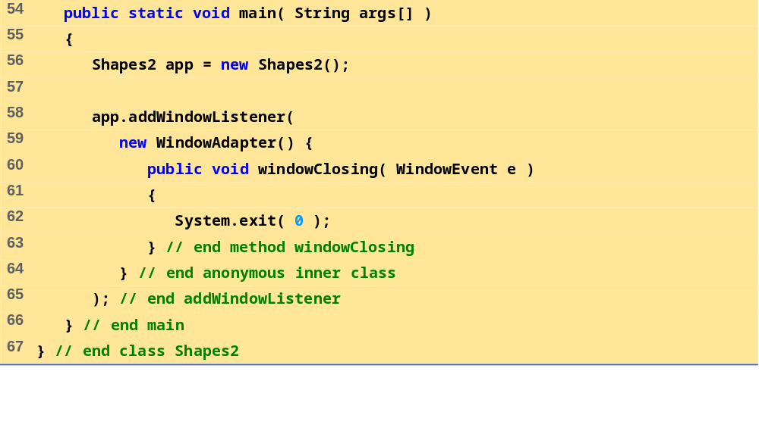
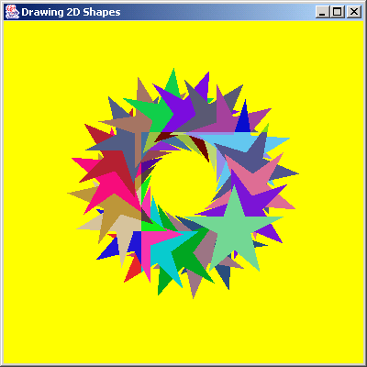
Shapes2.java (3 of 3)
Program Output

